Slide 1
Widgets
Musadaq Mansoor
(Credits to Marty Stepp and Stanford Computer Science)

Slide 2
Button
A clickable widget with a text label
represented by Button class in Java code
Button b = (Button) findViewById(R.id.theID);
key attributes:
android:clickable="bool" | set to false to disable the button
android:id="@+id/theID" | unique ID for use in Java code
android:onClick="function" | function to call in activity when clicked (must be public, void, and take a View arg)
android:text="text" | text to put in the button

Slide 3
Image Button
A clickable widget with an image label
to set up an image resource:
put image file in project folder app/src/main/res/drawable
use @drawable/foo to refer to foo.png
use simple file names with only letters and numbers

Slide 4
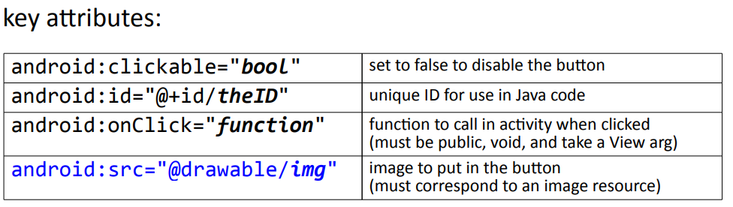

Slide 5
Image View
Displays an image without being clickable
to change the visible image, in Java code:
get the ImageView using findViewById
call its setImageResource method and pass R.drawable.filename
Key attributes:
android:id="@+id/theID" | unique ID for use in Java code
android:src="@drawable/img" | image to put in the screen

Slide 6
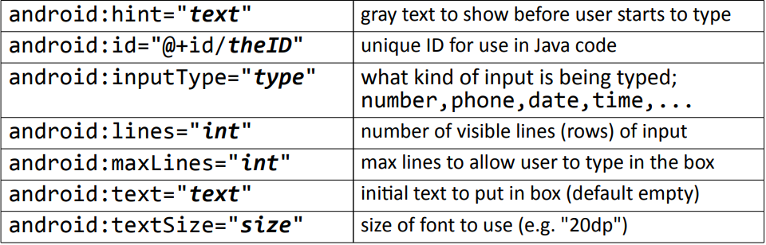
Edit Text
An editable text input box
Key attributes:

Slide 7
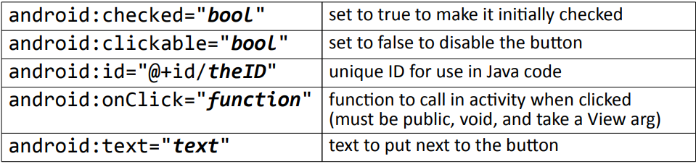
Radio Button
A toggleable on/off switch; part of a group
need to be nested inside a RadioGroup tag in XML so that only one can be selected at a time
Key attributes

Slide 8
Radio Group
<LinearLayout ...
android:orientation="vertical"
android:gravity="center|top">
<RadioGroup ...
android:orientation="horizontal">
<RadioButton ... android:id="@+id/lions"
android:text="Lions"
android:onClick="radioClick" />
<RadioButton ... android:id="@+id/tigers"
android:text="Tigers"
android:checked="true"
android:onClick="radioClick" />
<RadioButton ... android:id="@+id/bears"
android:text="Bears, oh my!"
android:onClick="radioClick" />
</RadioGroup>
</LinearLayout>

Slide 9
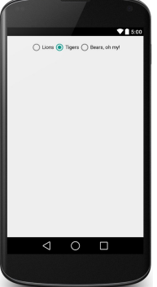

Slide 10
Reusing onClick handler
// in MainActivity.java
public class MainActivity extends Activity {
public void radioClick(View view) {
// check which radio button was clicked
if (view.getId() == R.id.lions) {
// ...
} else if (view.getId() == R.id.tigers) {
// ...
} else {
// bears ...
}
}

Slide 11
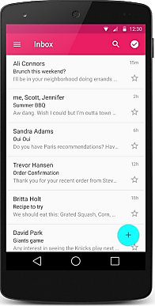
ListView
An ordered collection of selectable choices
key attributes in XML:
android:clickable="bool | set to false to disable the list
android:id="@+id/theID“ | unique ID for use in Java code
android:entries="@array/array | set of options to appear in the list (must match an array in strings.xml)

Slide 12
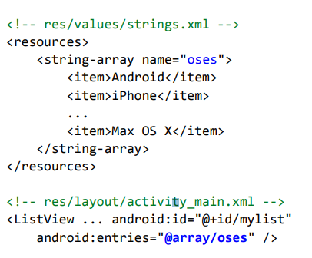
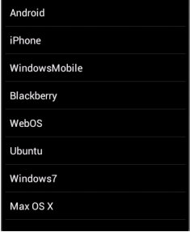
Static lists
static list: Content is fixed and known before the app runs.
Declare the list elements in the strings.xml resource file.

Slide 13
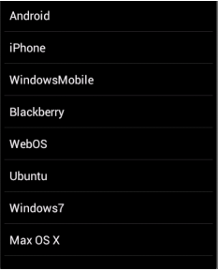
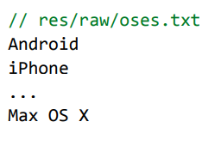
Dynamic lists
dynamic list: Content is read or generated as the program runs.
Comes from a data file, or from the internet, etc.
Must be set in the Java code.
Suppose we have the following file and want to make a list from it:

Slide 14
List adapters
adapter: Helps turn list data into list view items.
common adapters: ArrayAdapter, CursorAdapter
Syntax for creating an adapter:
ArrayAdapter name = new ArrayAdapter<String>(activity, layout, array);
the activity is usually this
the default layout for lists is android.R.layout.simple_list_item_1
get the array by reading your file or data source of choice
(it can be an array like String[], or a list like ArrayList<String>
Once you have an adapter, you can attach it to your list by calling the setAdapter method of the ListView object in the Java code.

Slide 15
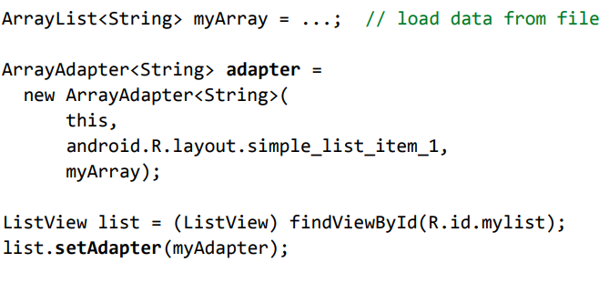
List adapter example

Slide 16
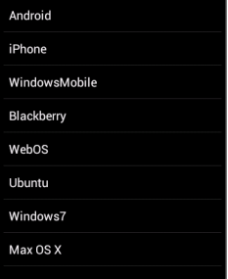
Handling list events
Unfortunately lists don't use a simple onClick event.
Several fancier GUI widgets use other kinds of events.
The event listeners must be attached in the Java code, not in the XML.
Understanding how to attach these event listeners requires the use of Java anonymous inner classes.
anonymous inner class: A shorthand syntax for declaring a small class without giving it an explicit name.
The class can be made to extend a given super class or implement a given interface.
Typically the class is declared and a single object of it is constructed and used all at once

Slide 17
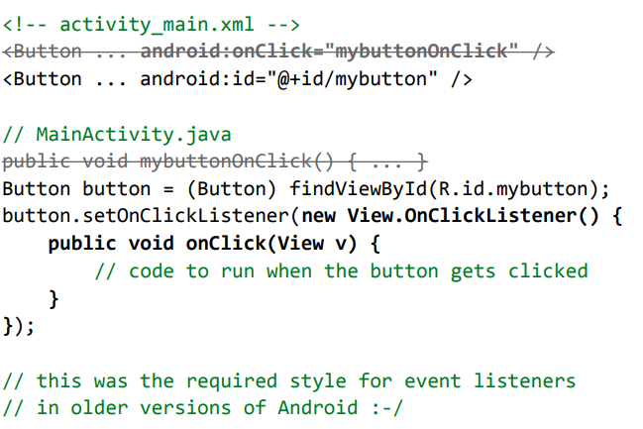
Attaching event listener in Java

Slide 18
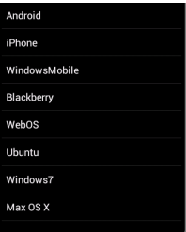
List events
List views respond to the following events:
setOnItemClickListener(AdapterView.OnItemClickListener) Listener for when an item in the list has been clicked.
setOnItemLongClickListener(AdapterView.OnItemLongClickListener) Listener for when an item in the list has been clicked and held.
Others:
onDrag, onFocusChanged, onHover, onKey, onScroll, onTouch, ...

Slide 19
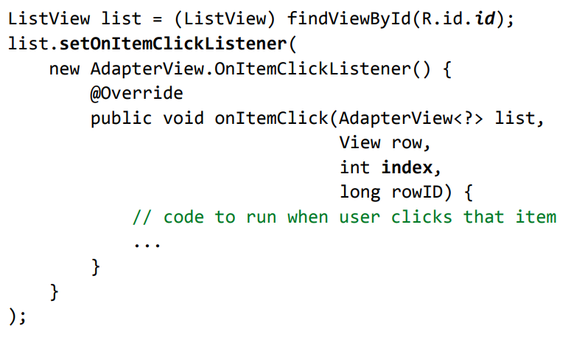
List event listener example

Slide 20
Thanks
Any Questions?

